Slide 1
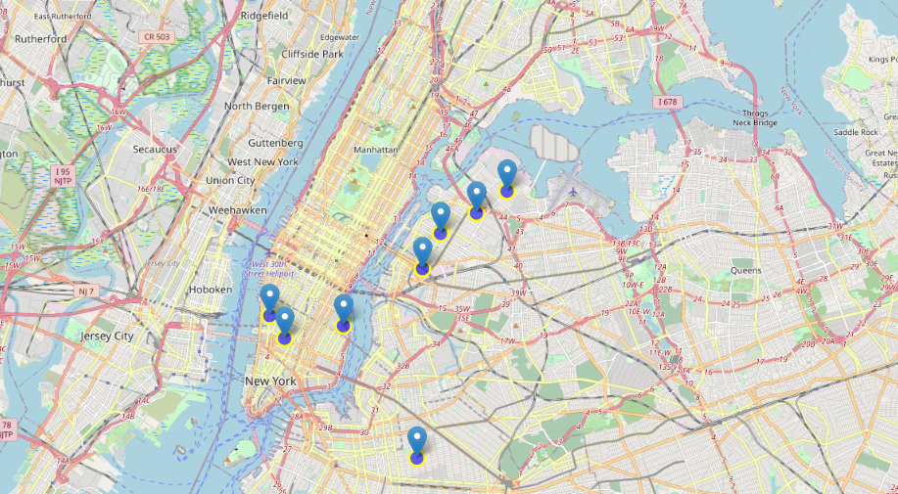
The Battle of Neighborhoods: Recommended System Based on the Neighborhoods Similarity
Applied Data Science Capstone | Fernandes Macedo Ribeiro

Slide 2
Table of Contents
Business Understanding
Data Understanding
Data Preparation & Cleaning
Modeling
Evaluation
Deployment
Conclusions
Applied Data Science Capstone | Fernandes Macedo Ribeiro

Slide 3
Business Understanding
Find insights about the neighborhoods of New York City to open a new Restaurant of Brazilian food.
Applied Data Science Capstone | Fernandes Macedo Ribeiro

Slide 4
Data Understanding
Data set : https://cocl.us/new_york_dataset
Description: This data set contains the required information. Moreover, we will use this data set to explore various neighborhoods of New York City.
Data set : Foursquare API
Data set : https://data.cityofnewyork.us/City-Government/Borough-Boundaries/tqmj-j8zm
Description: By using this geo, space data we will get the New York Borough boundaries that will help us visualize choropleth map.
Applied Data Science Capstone | Fernandes Macedo Ribeiro

Slide 5
Data Preparation & Cleaning
I had use the Foursquare API to get the top 100 venues with in a radius of 1000 meters for a given latitude and longitude. And with data um use an Explanatory Data Analysis to understand the data.
Applied Data Science Capstone | Fernandes Macedo Ribeiro

Slide 6
Modeling
In this part of the project, it was not necessary to include machine learning models, as the result was enough for the stakeholders to make the right decision on where to open the new Brazilian restaurant.
Applied Data Science Capstone | Fernandes Macedo Ribeiro

Slide 7
Evaluation
I have answered all posed business questions in the introduction of this project. Now it is up to the stakeholders to decide whether the new restaurant will open, only with the analysis of this data set, otherwise more data will be needed so that even a machine learning model is implemented.
Applied Data Science Capstone | Fernandes Macedo Ribeiro

Slide 8
Deployment
In this project, we are going to implement this feature in the future using simple linear regression algorithm with scikit-learn for simplicity, we will use Flask as it is a very light web framework.
Applied Data Science Capstone | Fernandes Macedo Ribeiro

Slide 9
Conclusions
Greenwich Villag (Manhattan), West Village (Manhattan), Astoria (Queens) are some of the best neighborhoods for Brazilian Cuisine.
Manhattan have potential to Brazilian Restaurant Market.
Bedford Stuyvesant ranks last in average rating of Brazilian Restaurants.
Manhattan is the best place to stay if you prefer Brazilian Cuisine.
Applied Data Science Capstone | Fernandes Macedo Ribeiro

